Slide 1
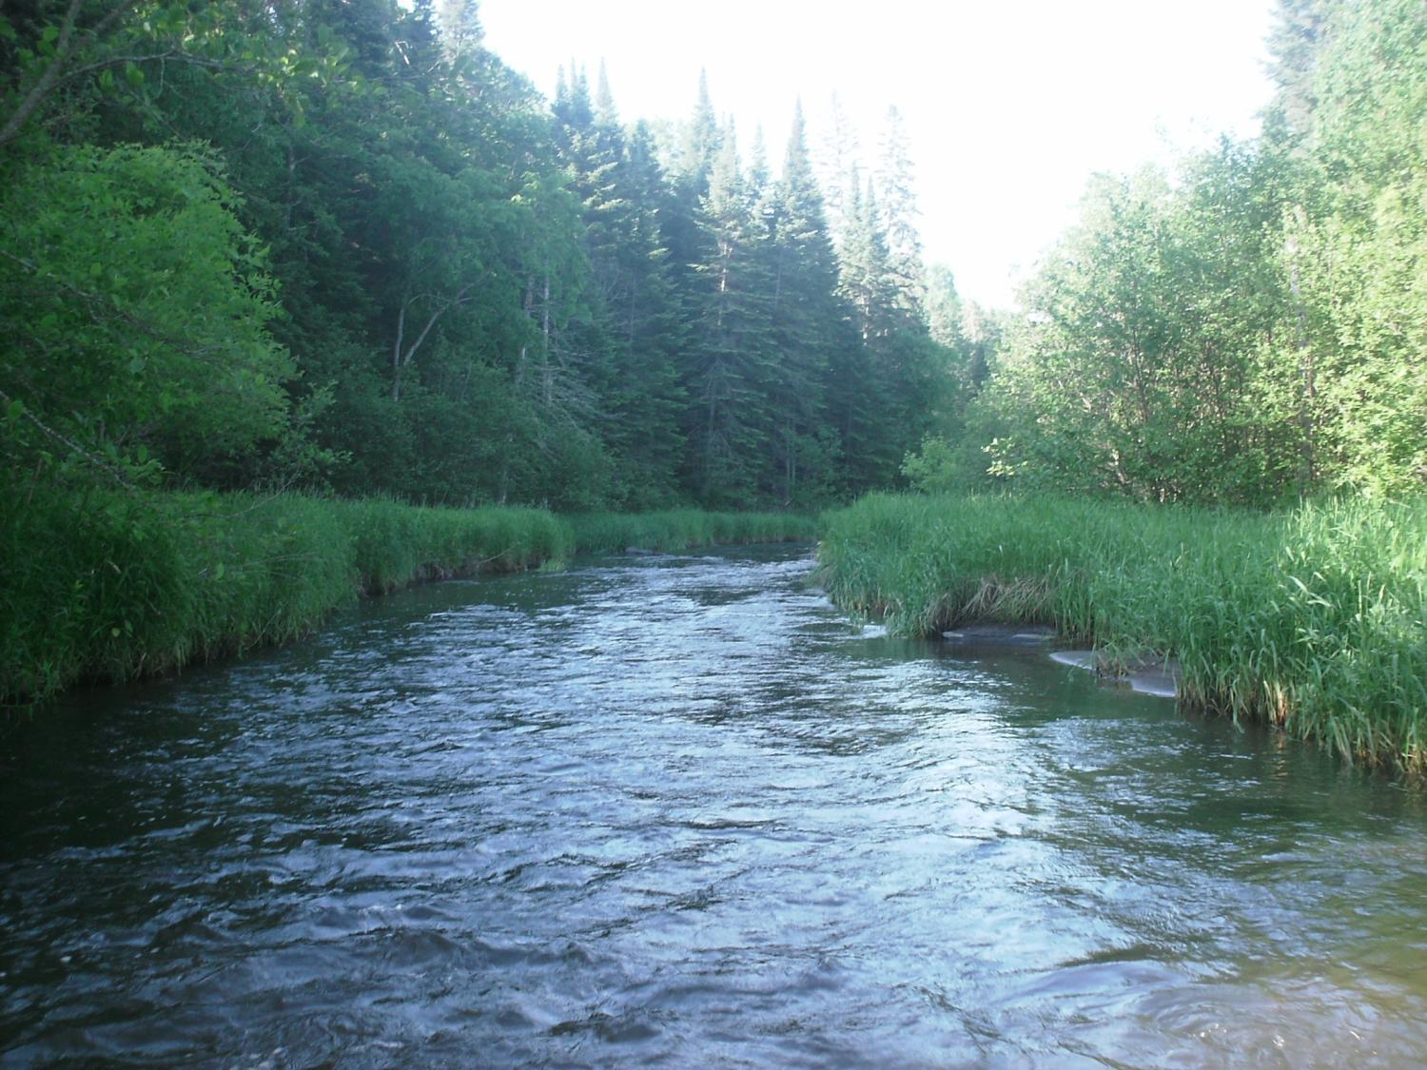
Legislative Water Commission
June 21, 2018
Co-chairs: Senator Wiger Representative Torkelson
Jim Stark, Director
Straight River, Becker County
1

Slide 2
Agenda
Call to Orders/Introductions
Approval of minutes: April 23
Discussion-MAWD tours
Introduction-2019 Recommendations
Next Steps- 2019 Recommendations
Summer LWC Schedule
Update-Clean Water Meeting
Updates on water-related bills- 2018

Slide 3
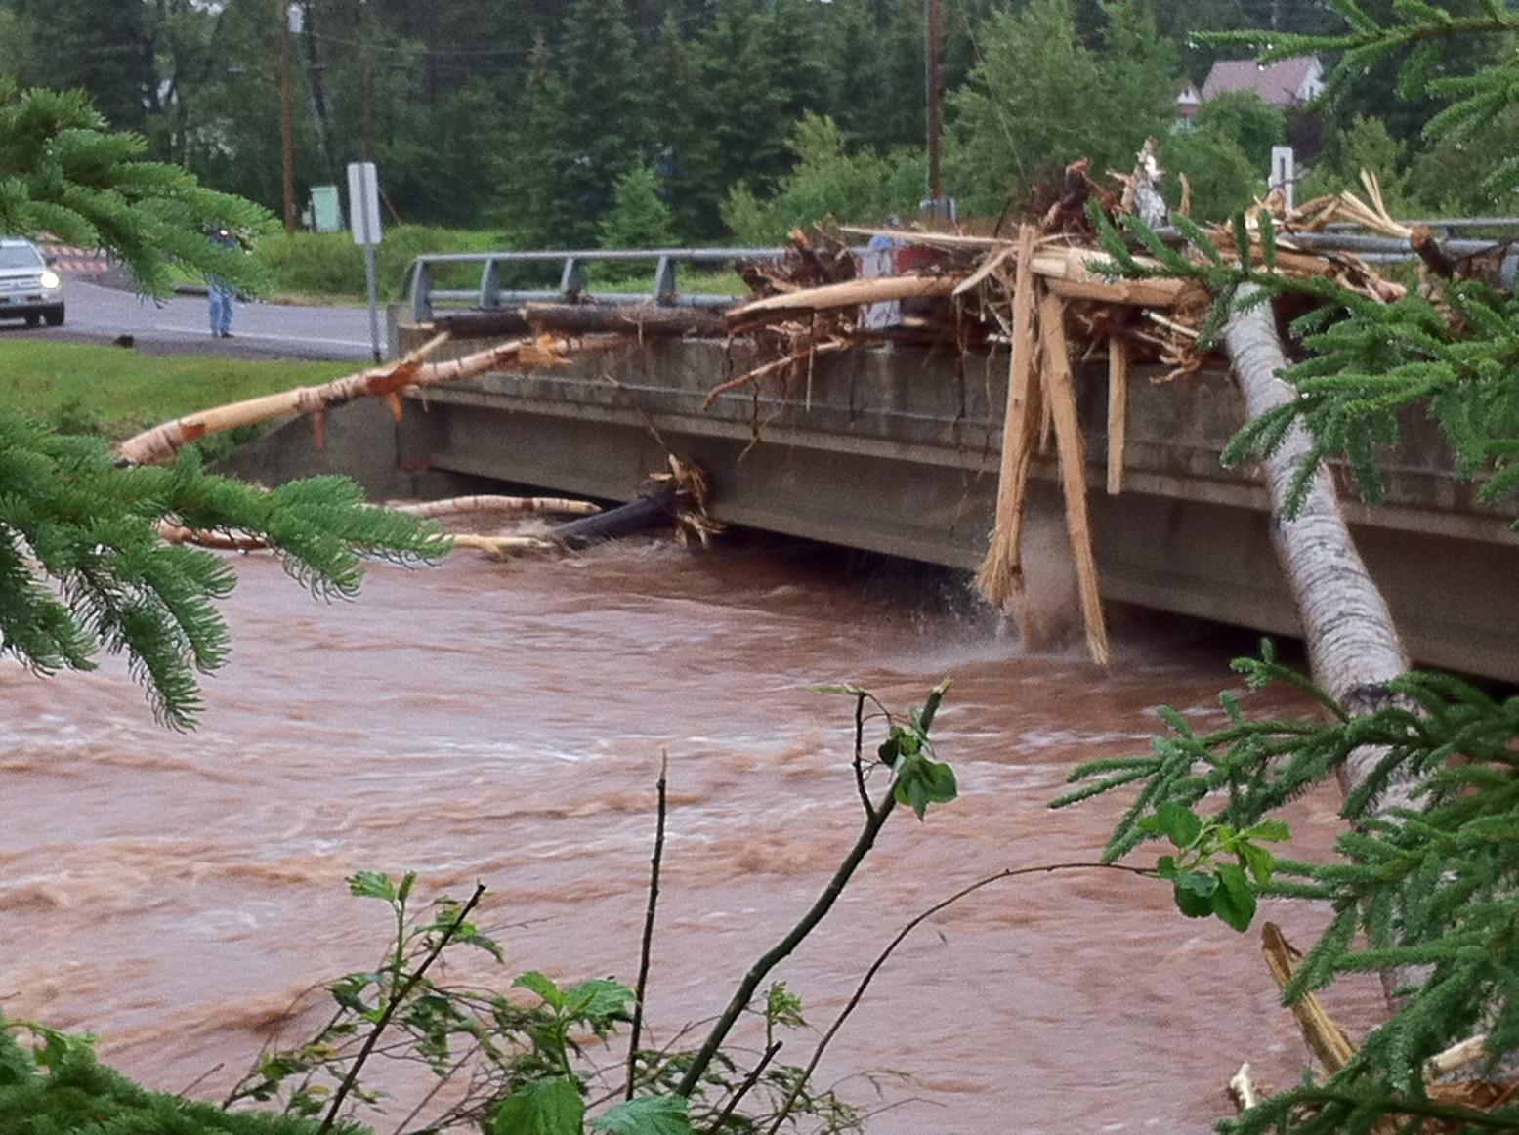
Recent Floods:
MN, WI and MI

Slide 4
2019 LWC Recommendations
Six Issues
4

Slide 5
LWC Priorities- 2019
2018 Process
Stakeholder Input
LWC Ranking Process
My Interpretations
Six Issues/Recommendations
Documents in Your Folders

Slide 6
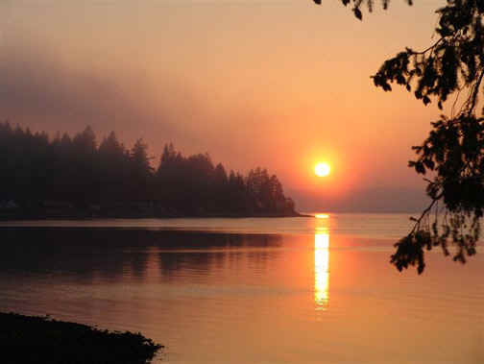
Process and This Meeting
Six Issues/Recommendations:
Consensus on all/some
Then, move forward:
Stakeholder/Agency/ LWC Feedback- Summer
LWC- Prioritization- Fall
Notes:
For more information and real time monitoring data you can visit this web site.

Slide 7
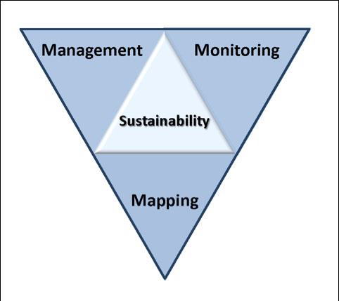
2019 LWC Issues and Recommendations
Topical areas
Waste-water*
Drinking water*
Groundwater
Sustainable Lakes
Water retention
Future state
* Short term
Notes:
Protection of ground water and surface water resources will require substantial investments from a diversity of funding sources over all levels of government during the next decade. As a part of this effort, this program of mapping, monitoring and managing is necessary to deliver the basic understanding of the hydrologic system for both surface and groundwater.

Slide 8
How Can the Recommendations be Used?
Legislation
Clean Water Council
LCCMR
Generate stakeholder support
Guide Agency programing
Notes:
Protection of ground water and surface water resources will require substantial investments from a diversity of funding sources over all levels of government during the next decade. As a part of this effort, this program of mapping, monitoring and managing is necessary to deliver the basic understanding of the hydrologic system for both surface and groundwater.

Slide 9
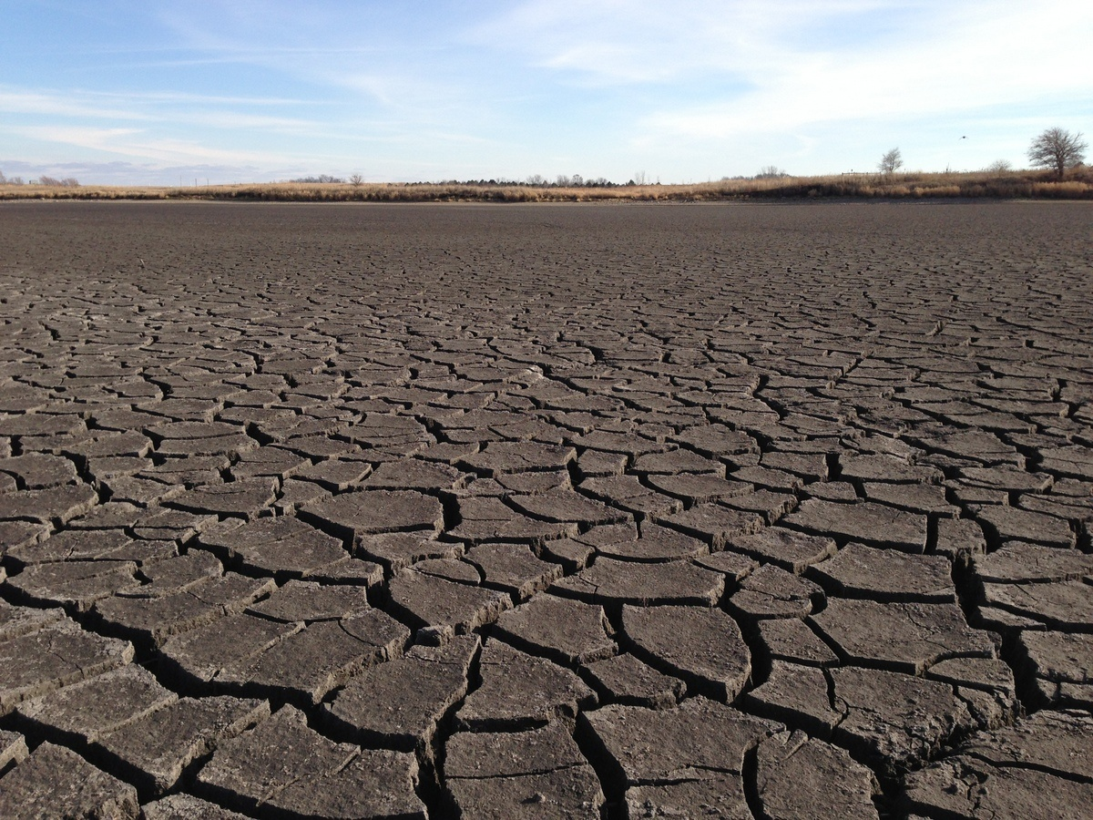
Issue: A Firm Foundation
1989- GW Act
1999- USGS Sustainability Report
2004- G16 Impaired Waters Plan (MPCA)
2005- DNR/GW Report
2006- Clean Water Legacy Act
2006- ENRTF Sustainability Report
2008- Clean Water Amendment
2008 Legislative Water Sustainability Framework
2009- EQB Sustainability Report
2012- GW Management Area Plans (DNR)
2017- Freshwater Society Reports on Water Sustainability
Time to move forward on this foundation
(Worthington, MN-2012)

Slide 10
Six Issue Areas
10

Slide 11
Issue #1: Wastewater/Storm water
Issues:
Vetted Last Session
Infrastructure Needs are Large
Nine Recommendations
Four Moved Forward
Some Legislative Success
Re- review Each Issue
Recommend Some Issues Again
11

Slide 12
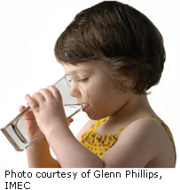
Issue # 2: Drinking Water
Issues:
Infrastructure Issues are Significant
Source-Water Protection for Rivers
Private Drinking Water: Threats include: Nitrate, Lead, Arsenic, Radon Bacteria, Viruses, Man-made Chemicals, Toxic Algae, Spills
Some Recommendations:
Source Water Protection for Rivers
Attention to Private wells
Infrastructure for Water Systems
Evaluate the GW Protection Rule
Notes:
What we hope to leave you with is a much better understanding of our state’s groundwater resources and appreciation for the challenges we face.
Simply stated the problem we are increasingly recognizing is that there are ….

Slide 13
Issue #3: Groundwater Sustainability:
Will We Run Out?
Issues:
Warning Signs
Noted First In Lakes and Streams
Issues are Well Documented
A Few Recommendations
Balance our Water Bank Account
Assess our Water Balance (1W/1 Plan)
Economic Analysis-How Important?
Automate the Permit Process
Interactions GW/Lakes/Biology
Notes:
For more information and real time monitoring data you can visit this web site.

Slide 14
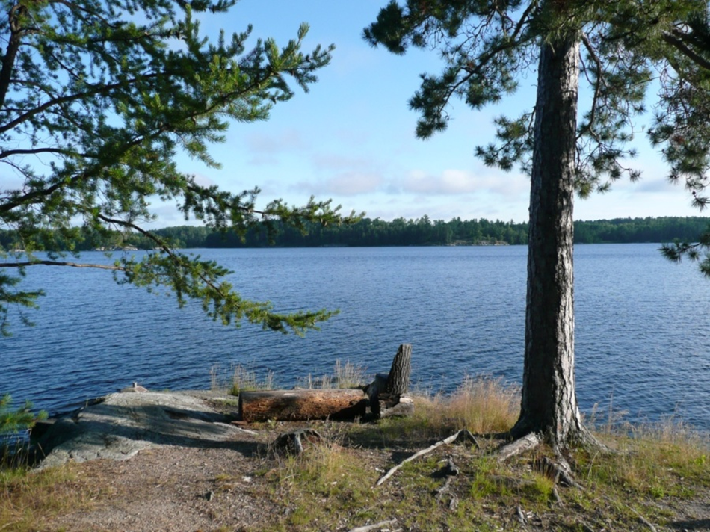
Issue # 4: Sustainable Lakes
Issues: Many Threats
GW Pumping
Chemicals/ Nutrients
Algae
Invasive Species
Warming Climate
A Few Recommendations:
Establish Status and Goals- Statewide
Protect Shorelines
Management of Deep and Shallow Lakes
Leaking Septic/Wastewater
Economic Value of our Lakes

Slide 15
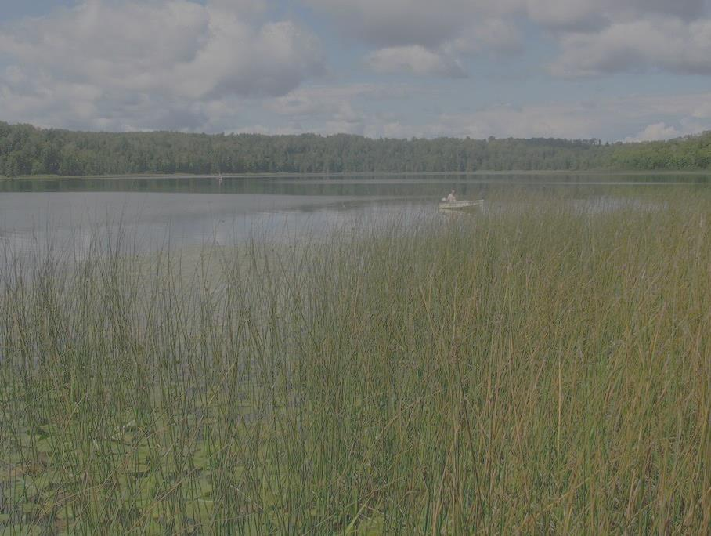
Issue #5:Water Retention
Issues and Challenges:
Drainage is an Urban and Rural Problem
Drainage affects our GW, Streams and Lakes
Nutrients, Erosion, Stream Sediment
Status and a Few Recommendations:
Understand Extent of Drainage Problem
Evaluate Urban BMPs
Drainage affects GW recharge/Water Balances?
Assess BMPs for Individual Landscapes
Support Recommendations of the DWG
Incentivize the Right BMPs in the Right Areas

Slide 16
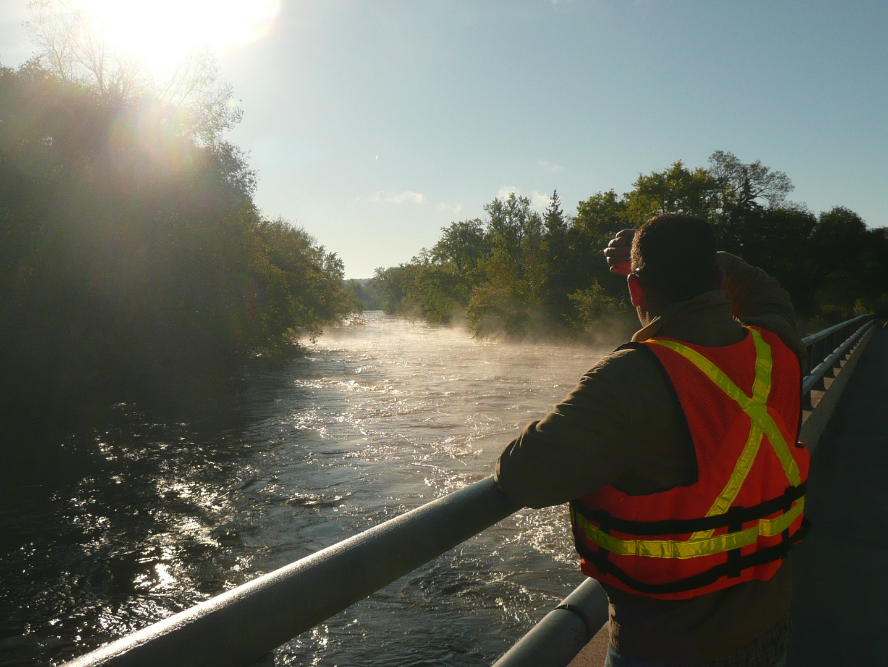
Issue # 6: Desired Future State for Water
Issues:
Citizen Expectations of the legacy Act
Economic Value Land of 10,000 lakes
Threats are Real
Our Legacy
Not Clear about Expectations or How to get there
A Few Recommendations:
What is our Desired Future State?
Protect, Enhance, Maintain?
Recognize the Full Cost of Water
Keep Water on the Lands
Adopt Mining and Climate Adaption Policy
Process to Achieve Goals

Slide 17
2019 LWC Issues and Recommendations
Topical areas
Waste-water*
Drinking water*
Groundwater
Sustainable Lakes
Water retention
Future state
* Short term
Notes:
Protection of ground water and surface water resources will require substantial investments from a diversity of funding sources over all levels of government during the next decade. As a part of this effort, this program of mapping, monitoring and managing is necessary to deliver the basic understanding of the hydrologic system for both surface and groundwater.

Slide 18
Process
LWC Consensus on all/some, then:
Stakeholder/Agency Feedback
Issue Prioritization
Discussion
Notes:
For more information and real time monitoring data you can visit this web site.

Slide 19
Agenda
Summer LWC Schedule
July 23 (Monday--a change from July 16) Meeting and field tour—urban water management: Full Day
August 20 (Monday) Meeting and field tour—rural water management: Full Day
Stakeholder Issue Meetings to be scheduled
Visits to your Districts?

Slide 20
Agenda
Update-Clean Water Meeting
BWSR: programs and project updates
Updates on water-related bills- 2018
The clean water supplemental appropriation bill was included in the House Legacy bill but was not heard in the Senate
Watershed restoration bill was included in the supplemental budget bill--eventually vetoed.
Wastewater Infrastructure: Partial success in the bonding bill. Also, appropriations from the Trust Fund.

Slide 21
THANKS
Notes:
For more information and real time monitoring data you can visit this web site.

